Slide 1
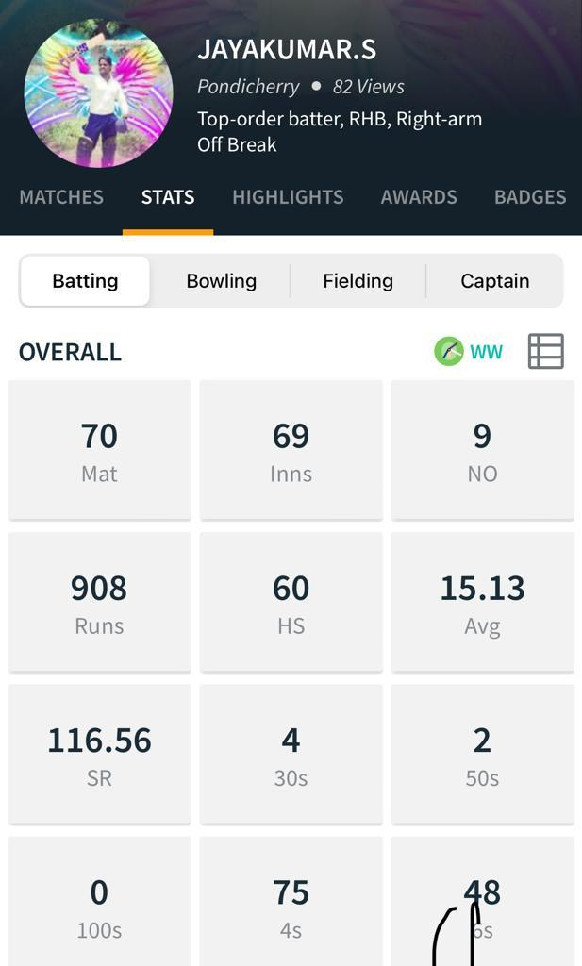
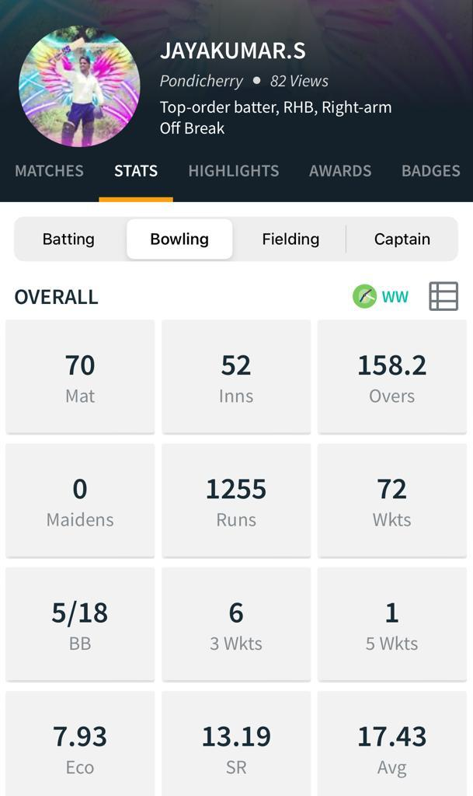

Jayakumar bpl001

Slide 2
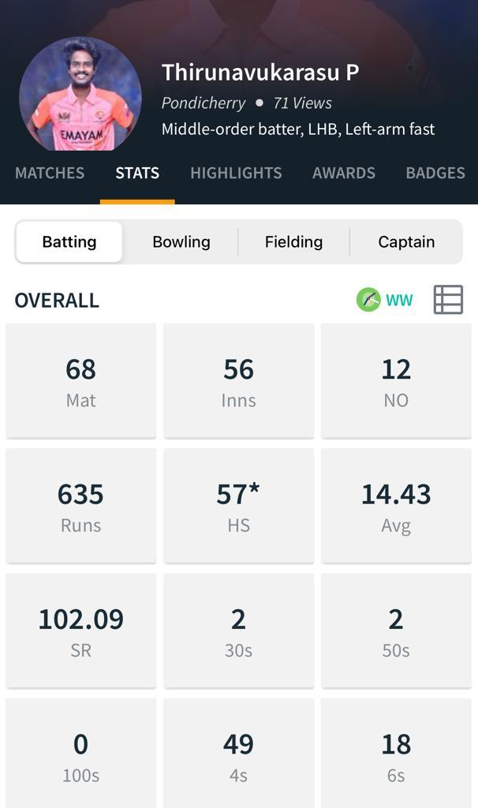
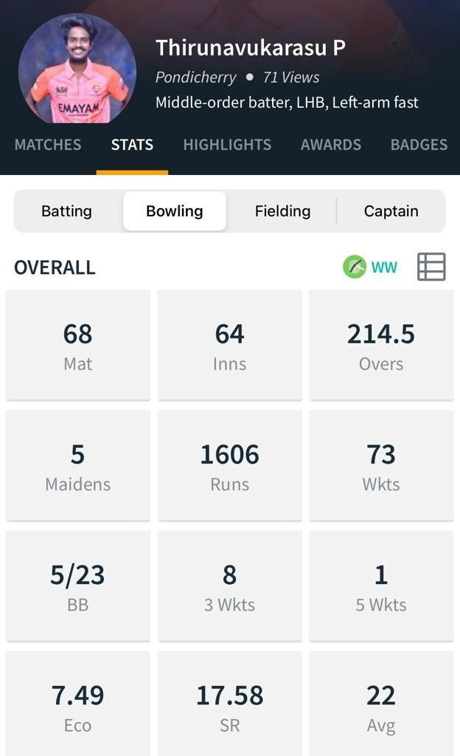
thirunavukarasu bpl002

Slide 3
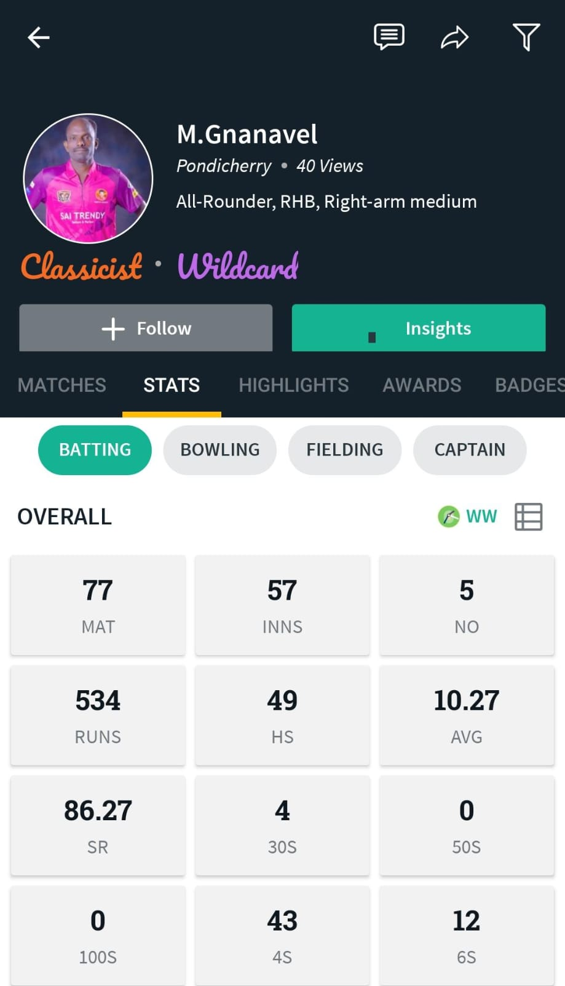
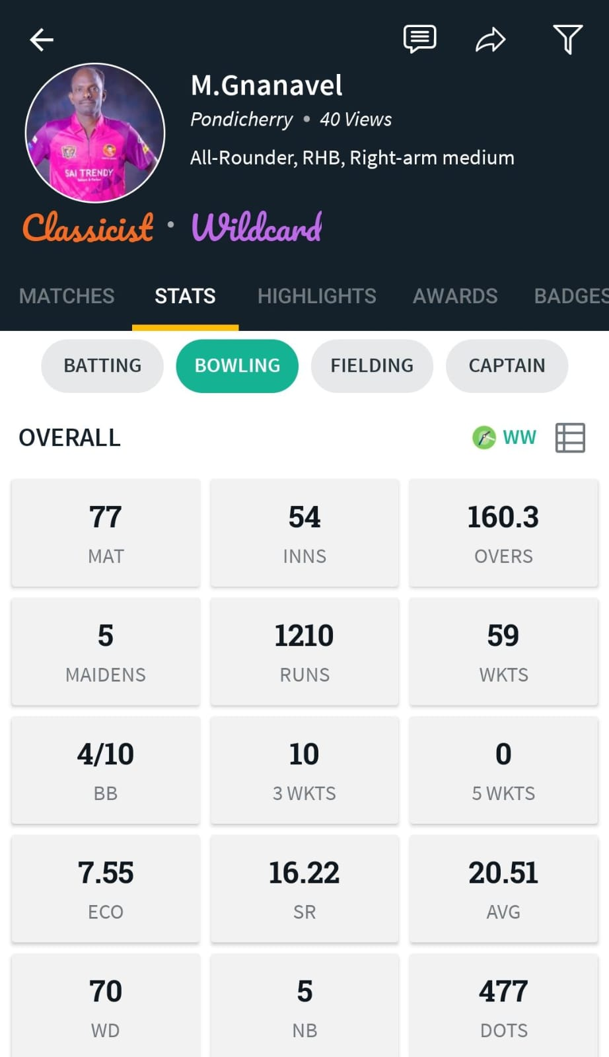
Gnanavel m bpl003

Slide 4
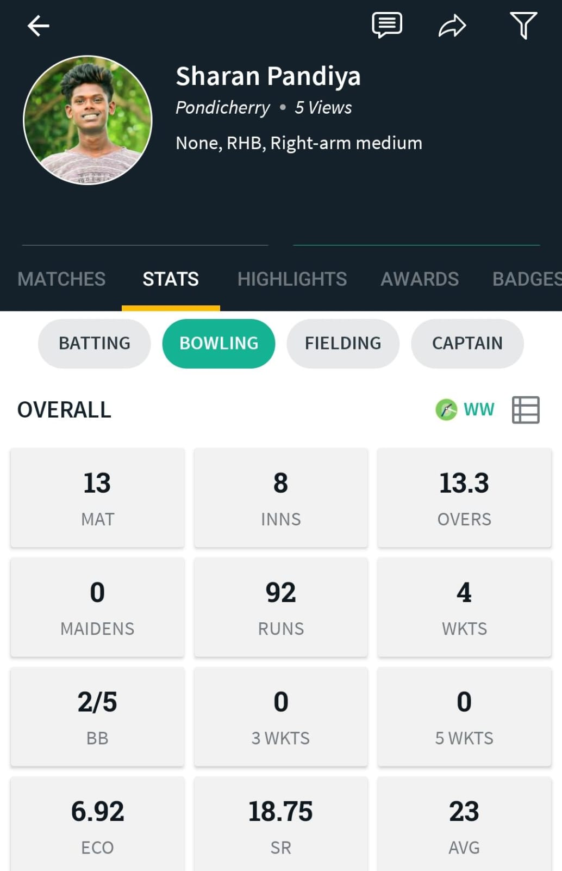
Sharan s bpl004

Slide 5
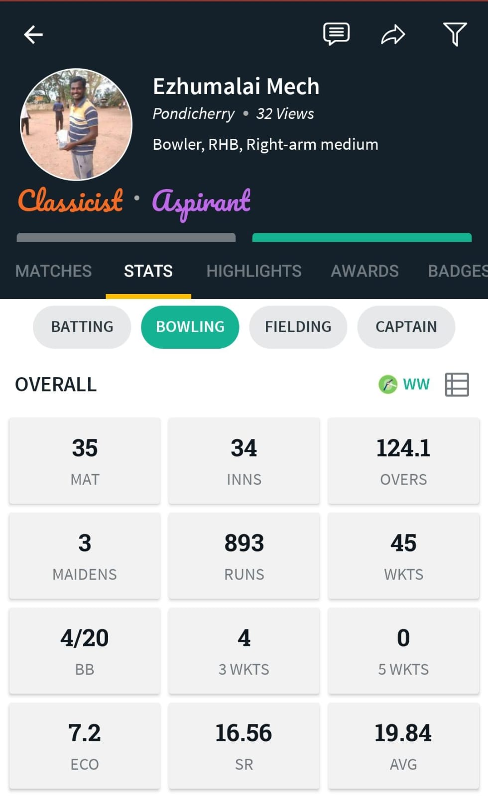
Ezhumalai k bpl005

Slide 6
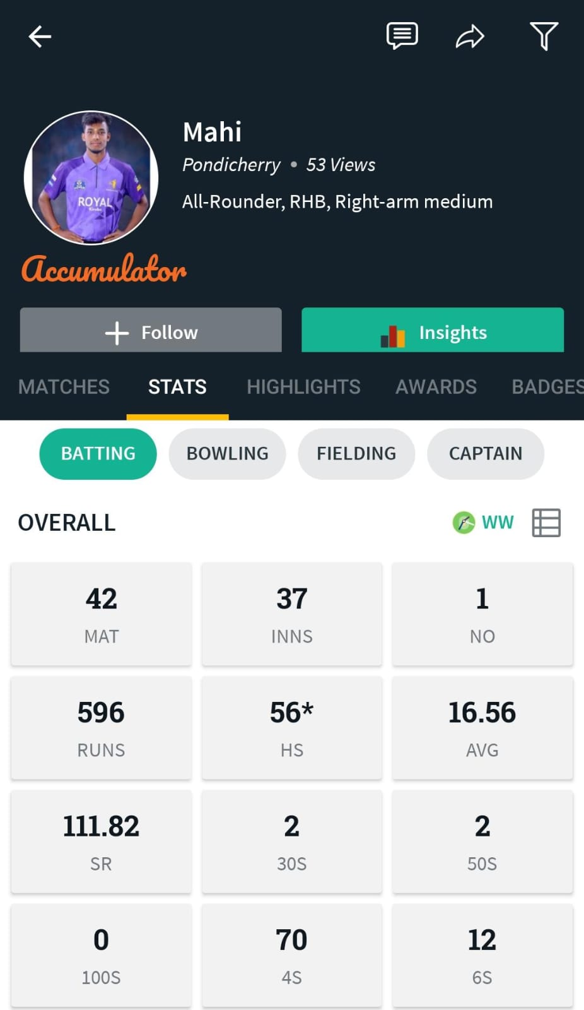
maHIVARMAN A bpl006

Slide 7
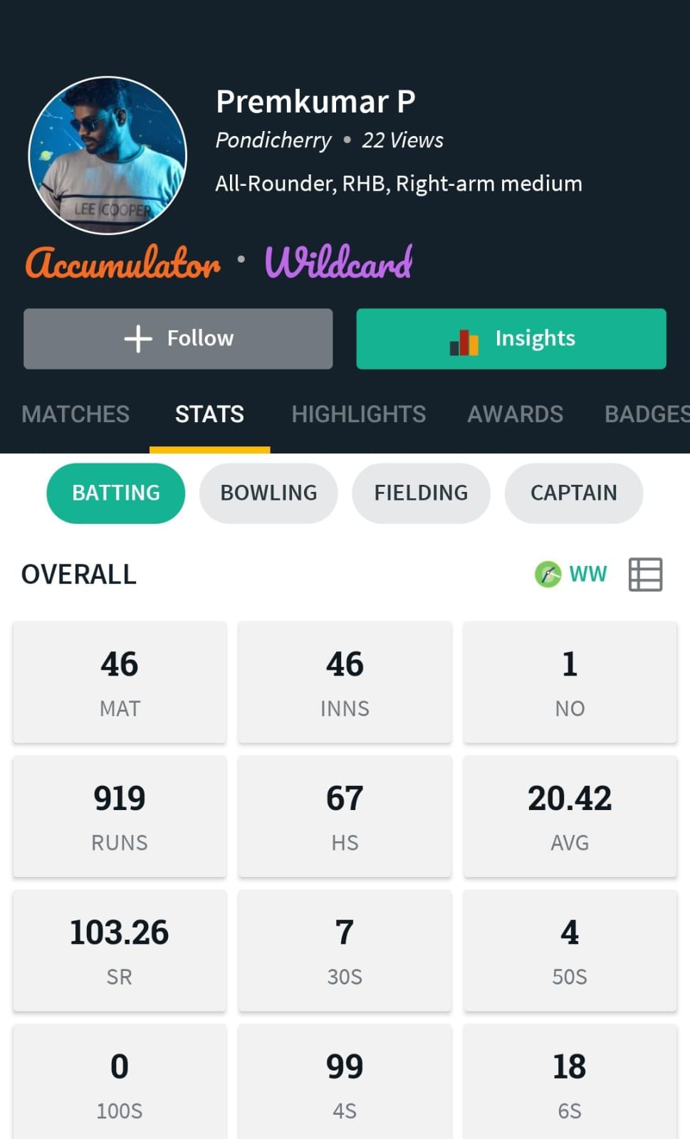
PREMKUMAR P bpl007

Slide 8
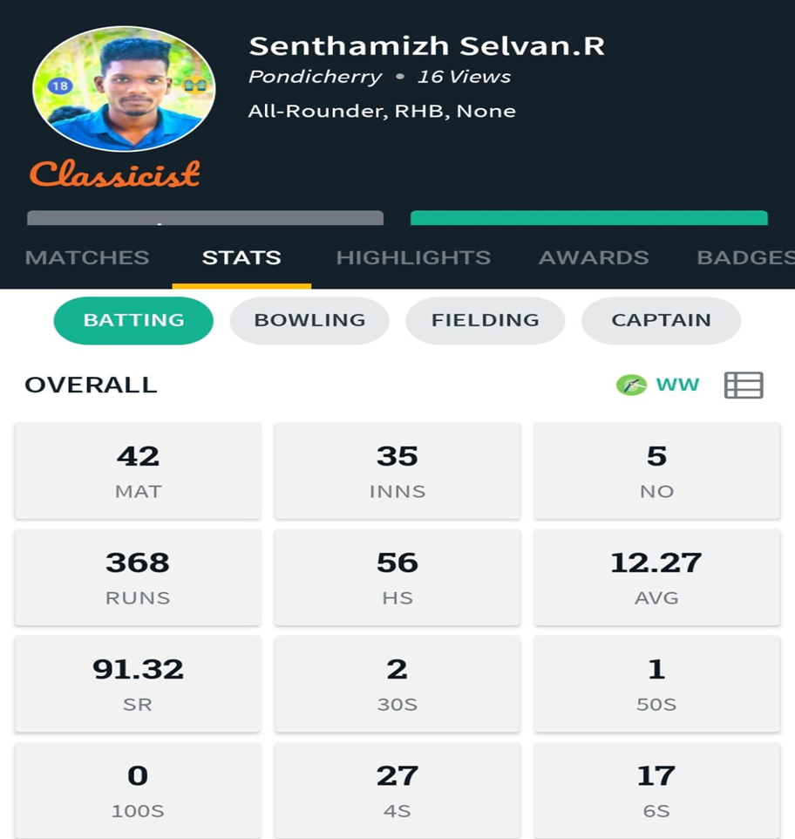
SENTHAMIZH SELVAN (WK) bpl008

Slide 9
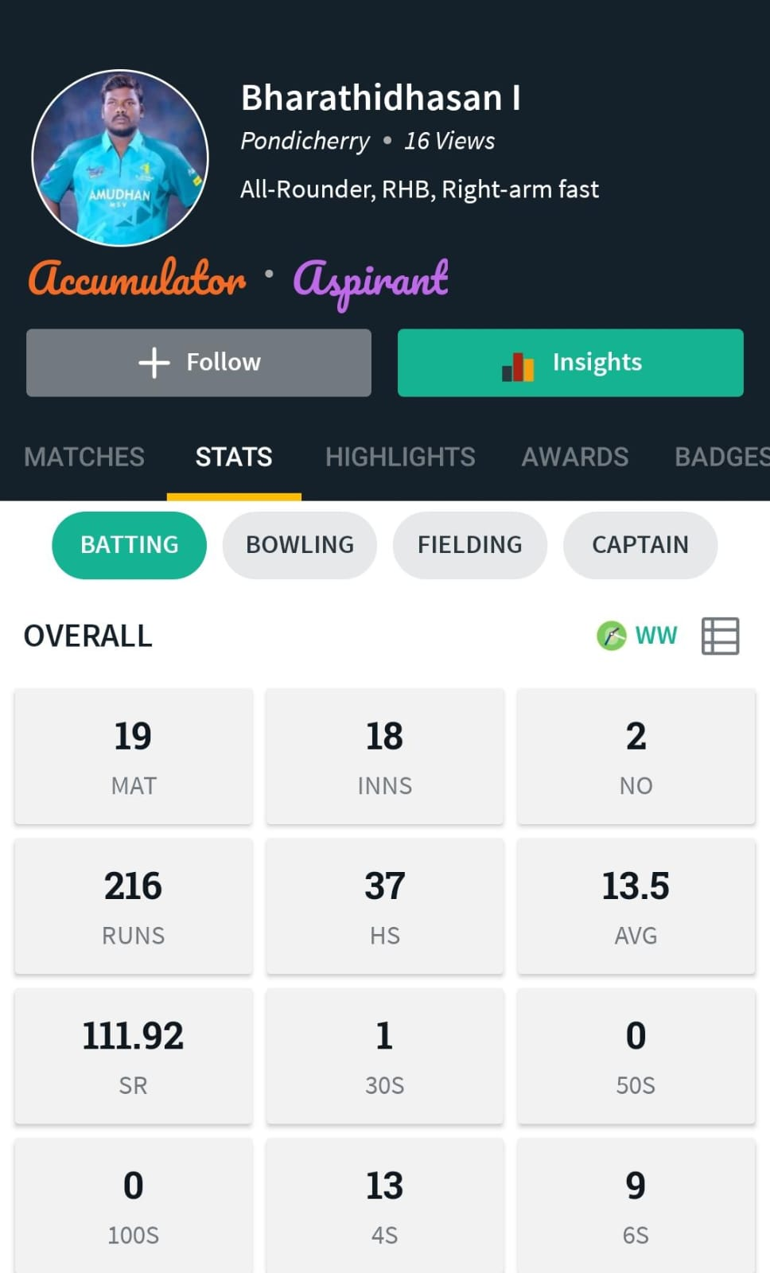
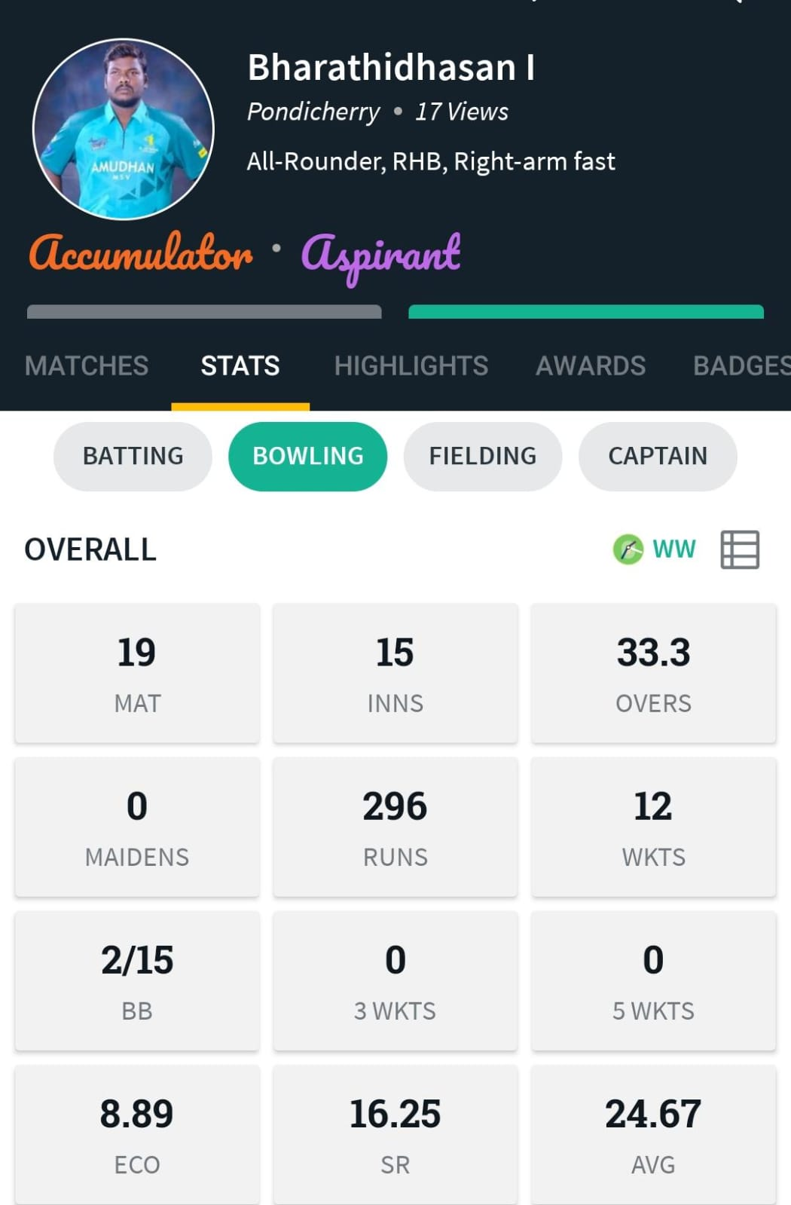
BHARATHIDASAN bpl009

Slide 10
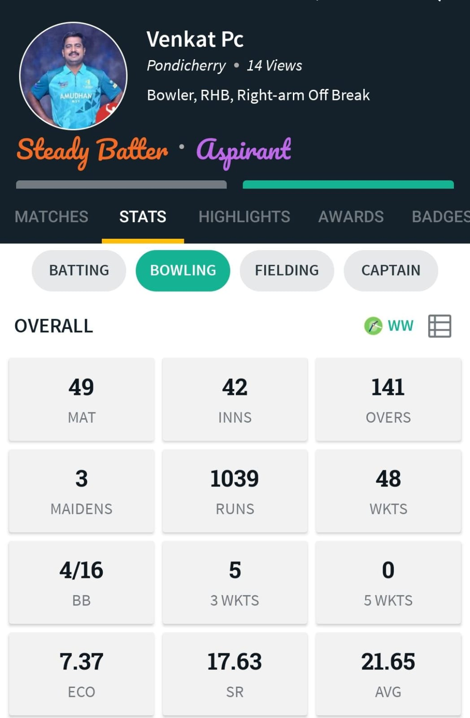
VENKAT S bpl010

Slide 11
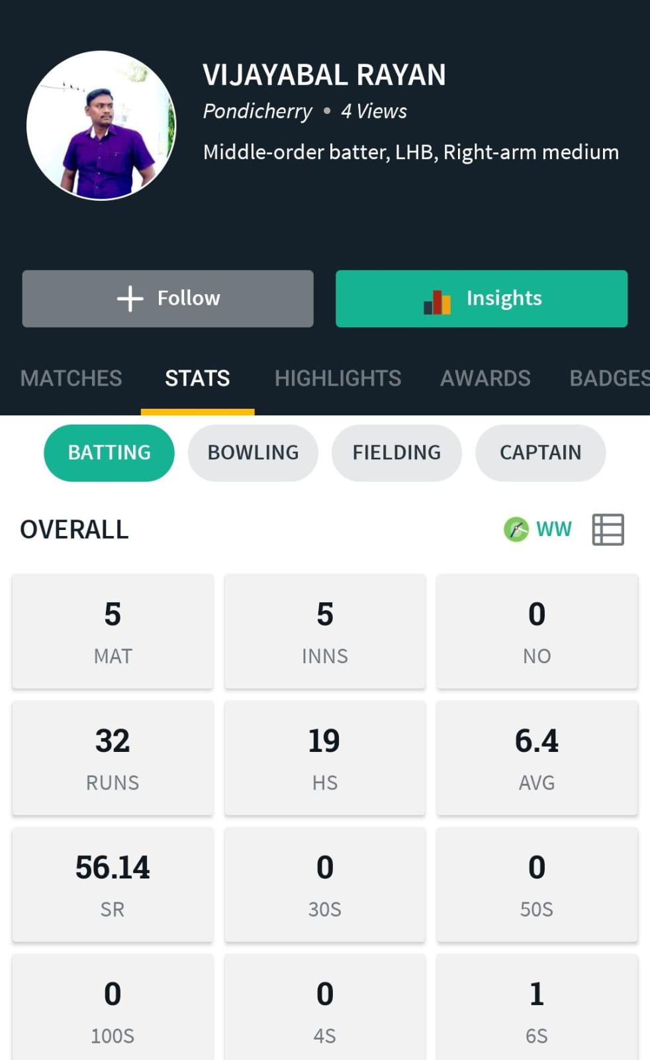
VIJAYABAL S bpl011

Slide 12
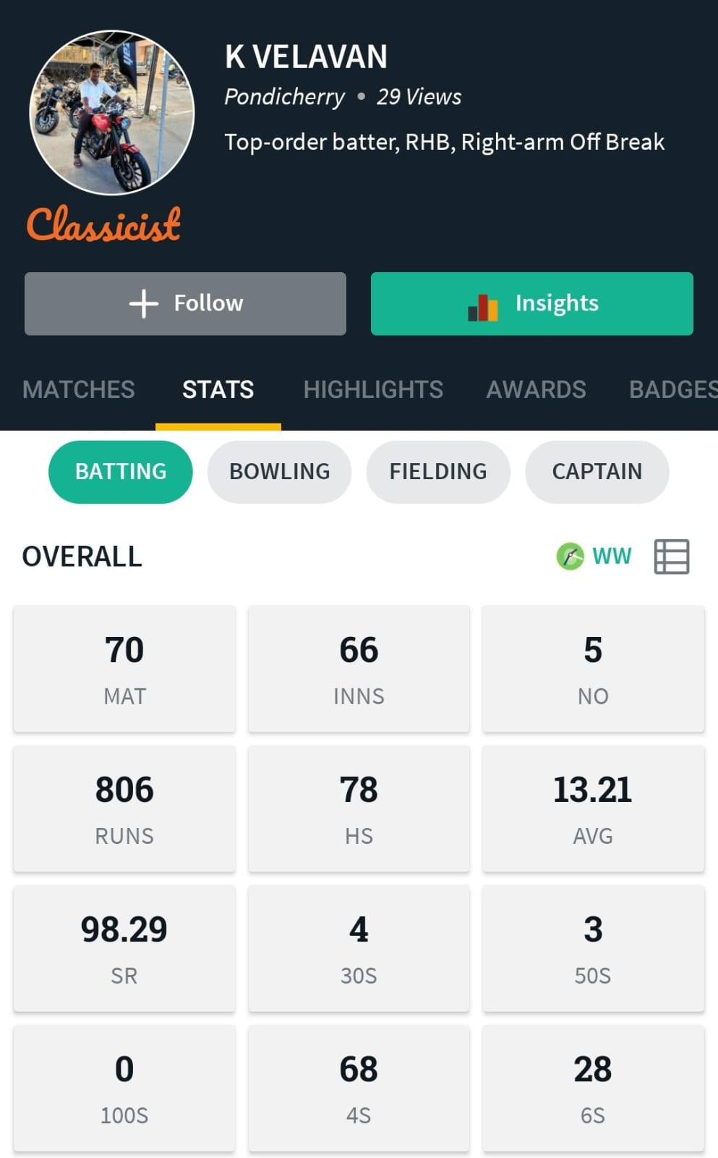
VELAVAN K bpl012

Slide 13
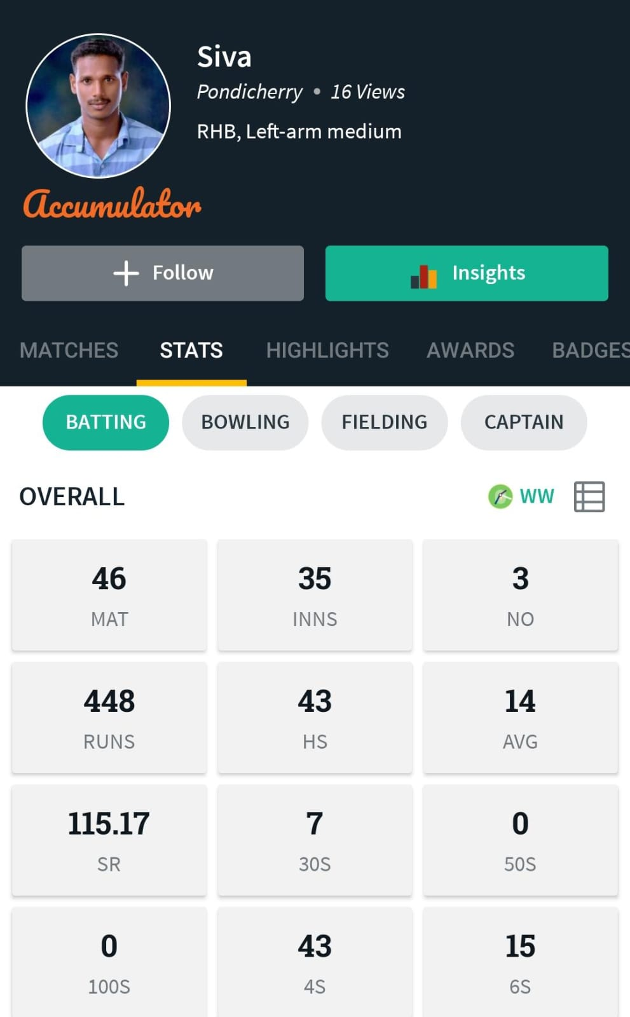
SIVA S (WK) bpl013

Slide 14
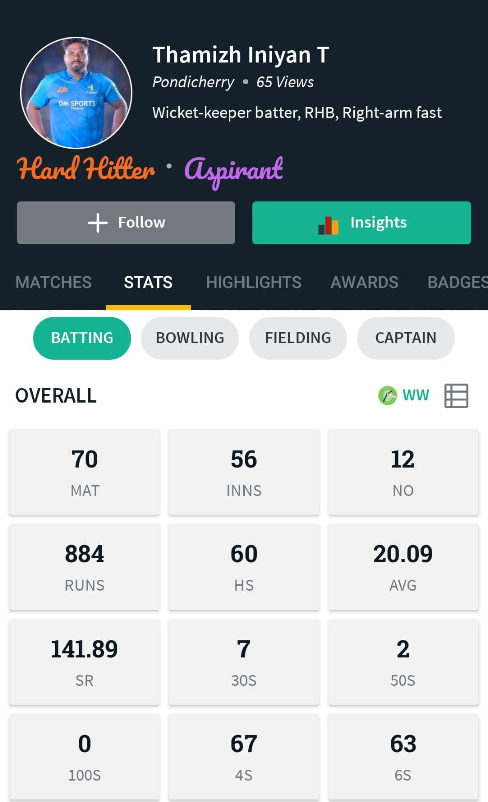
THAMIZH INIYAN T bpl014

Slide 15
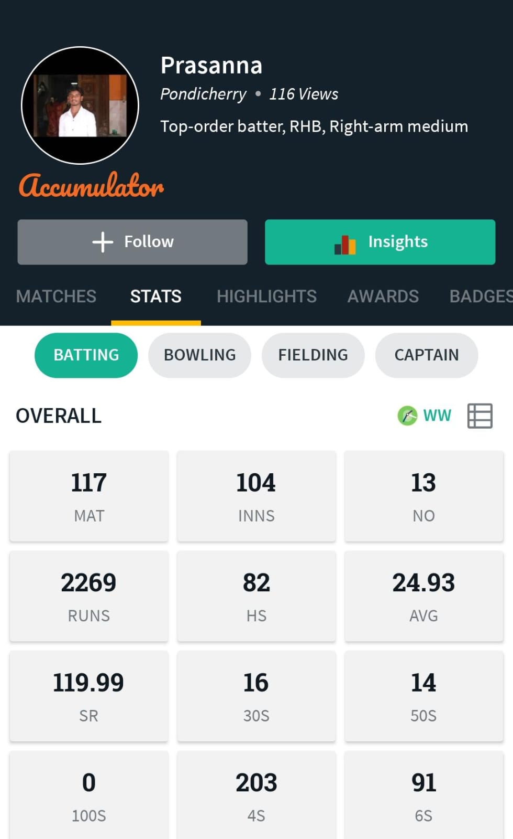
PRASANNA P bpl015

Slide 16
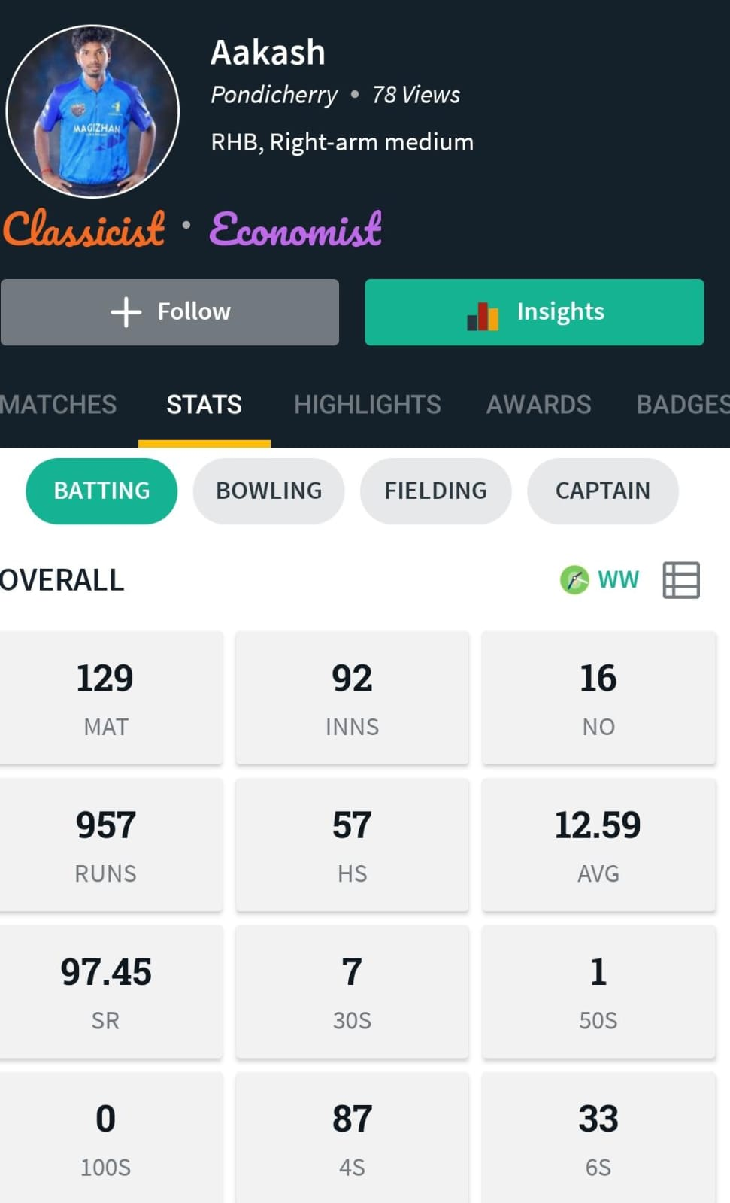
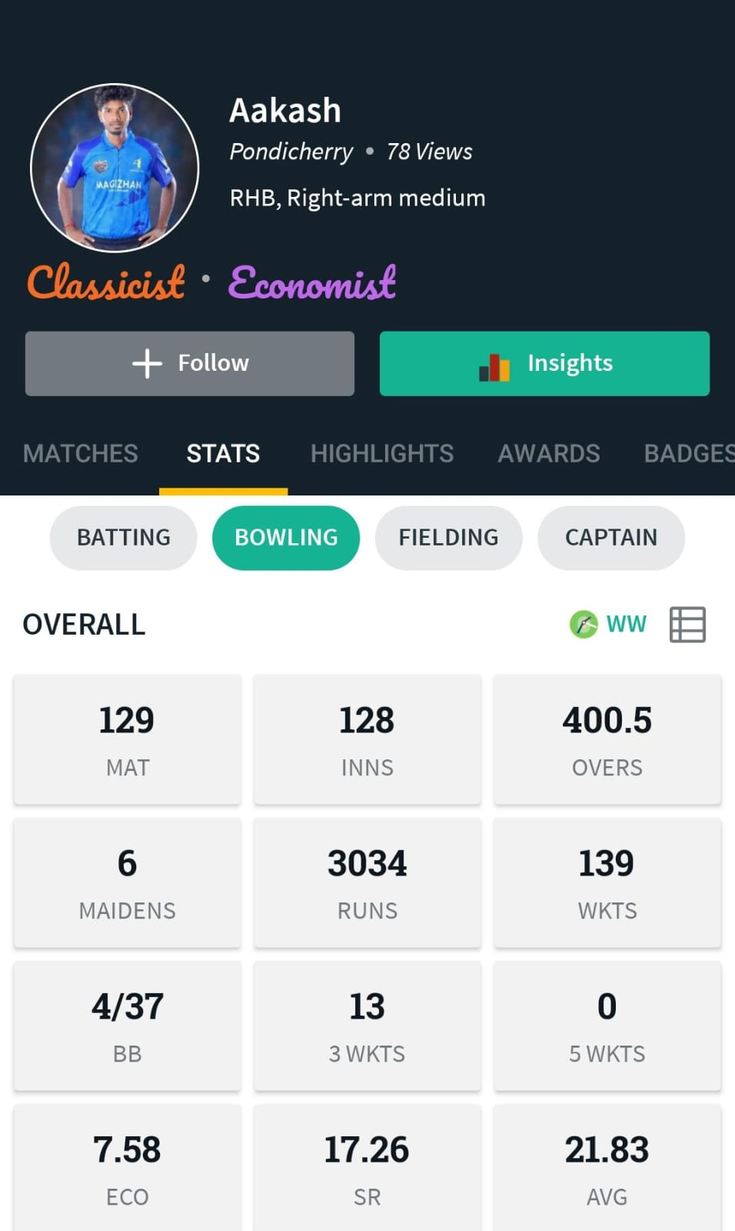
AKASH P bpl016

Slide 17
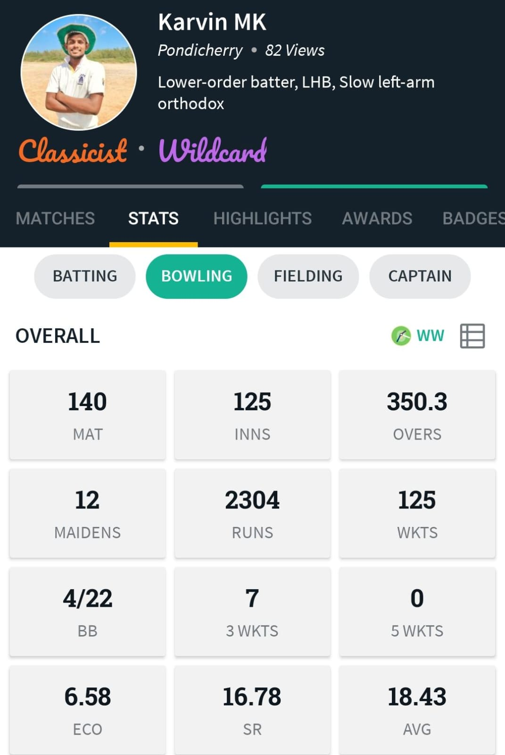
KARVINRAJ M bpl017

Slide 18
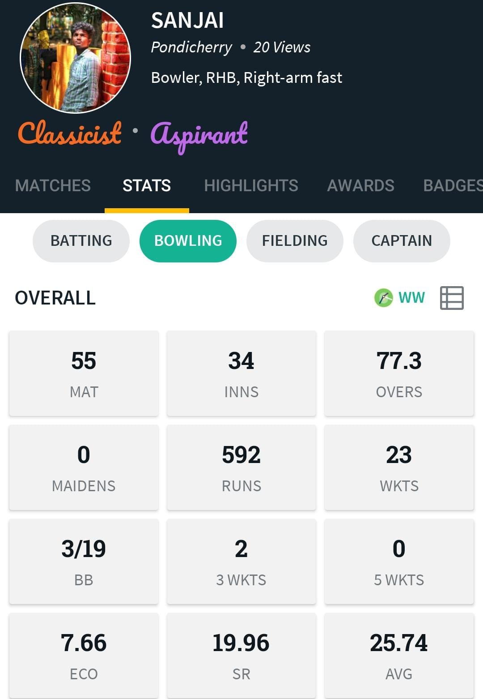
SANJAI M bpl018

Slide 19
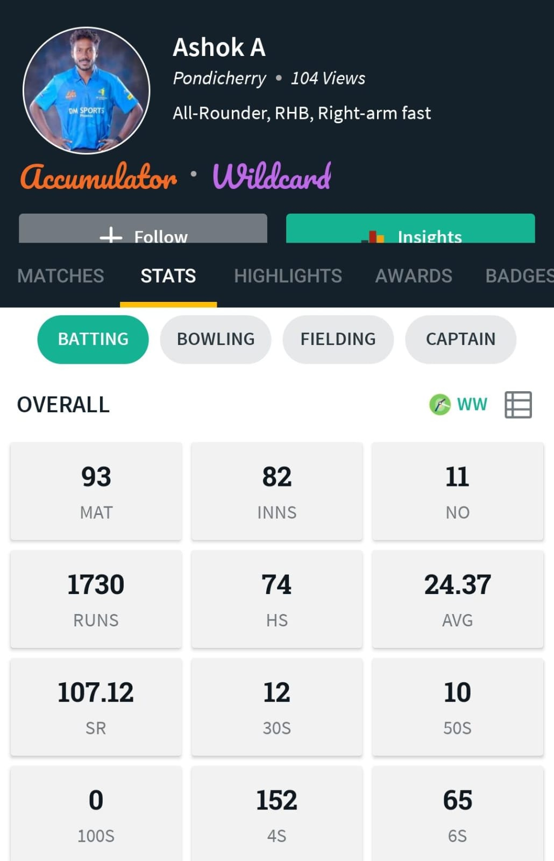
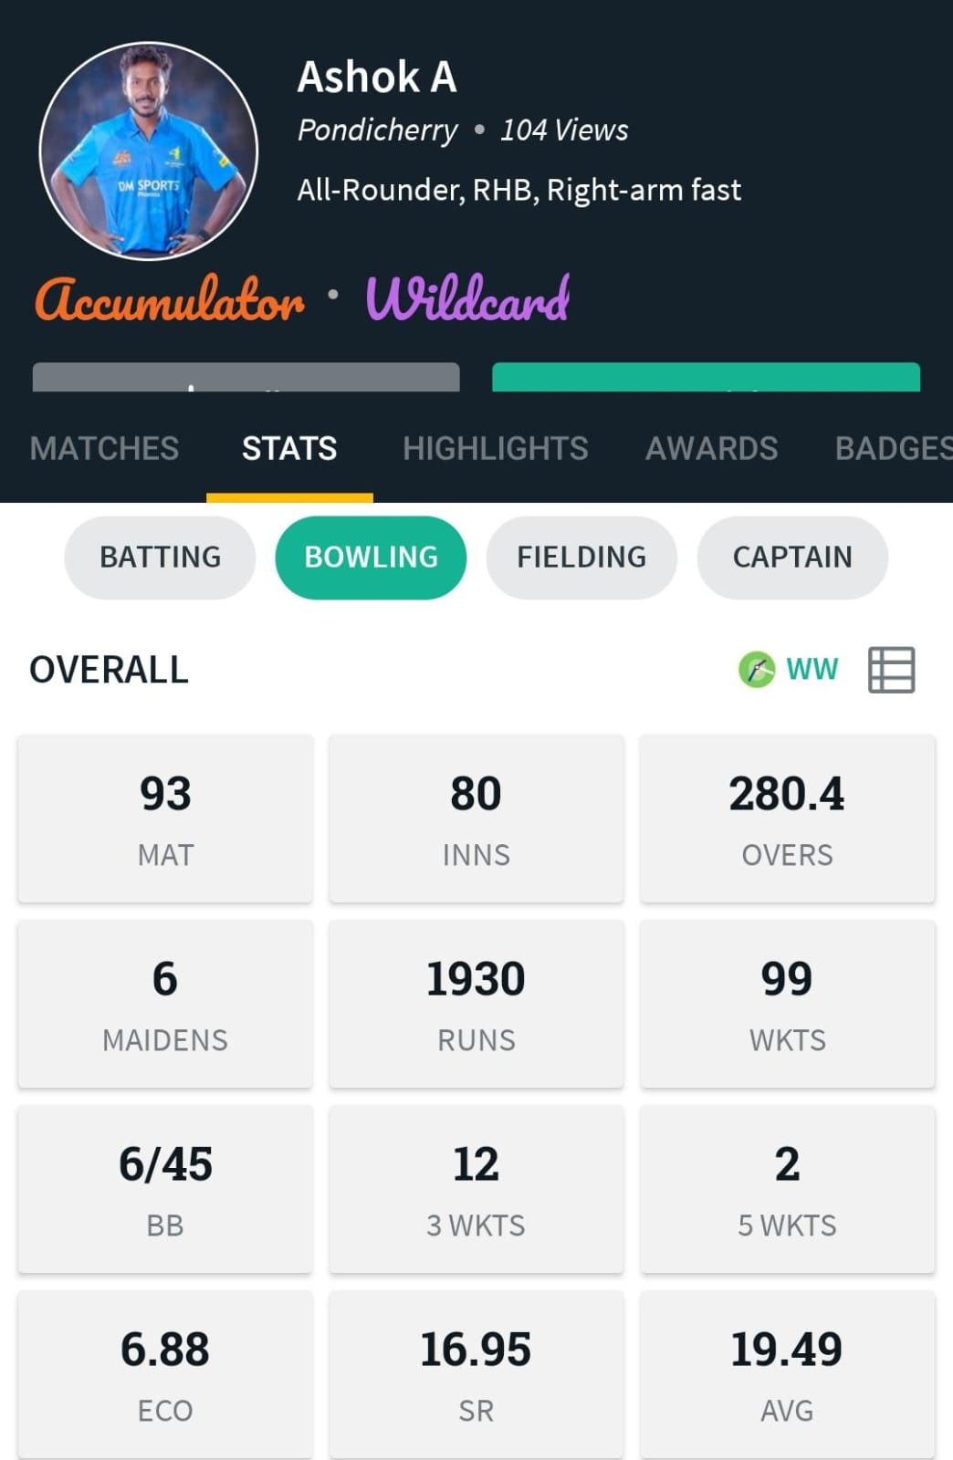
ASHOK KUMAR A bpl019

Slide 20
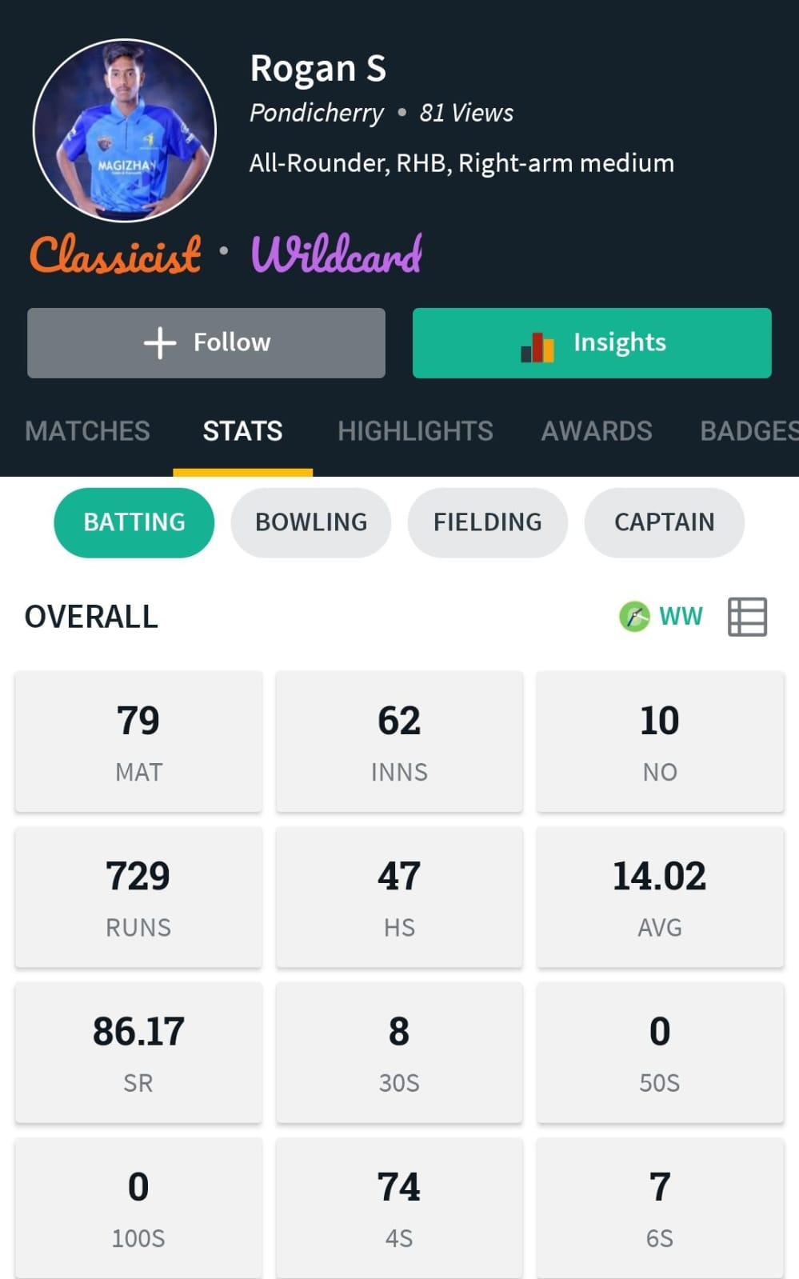
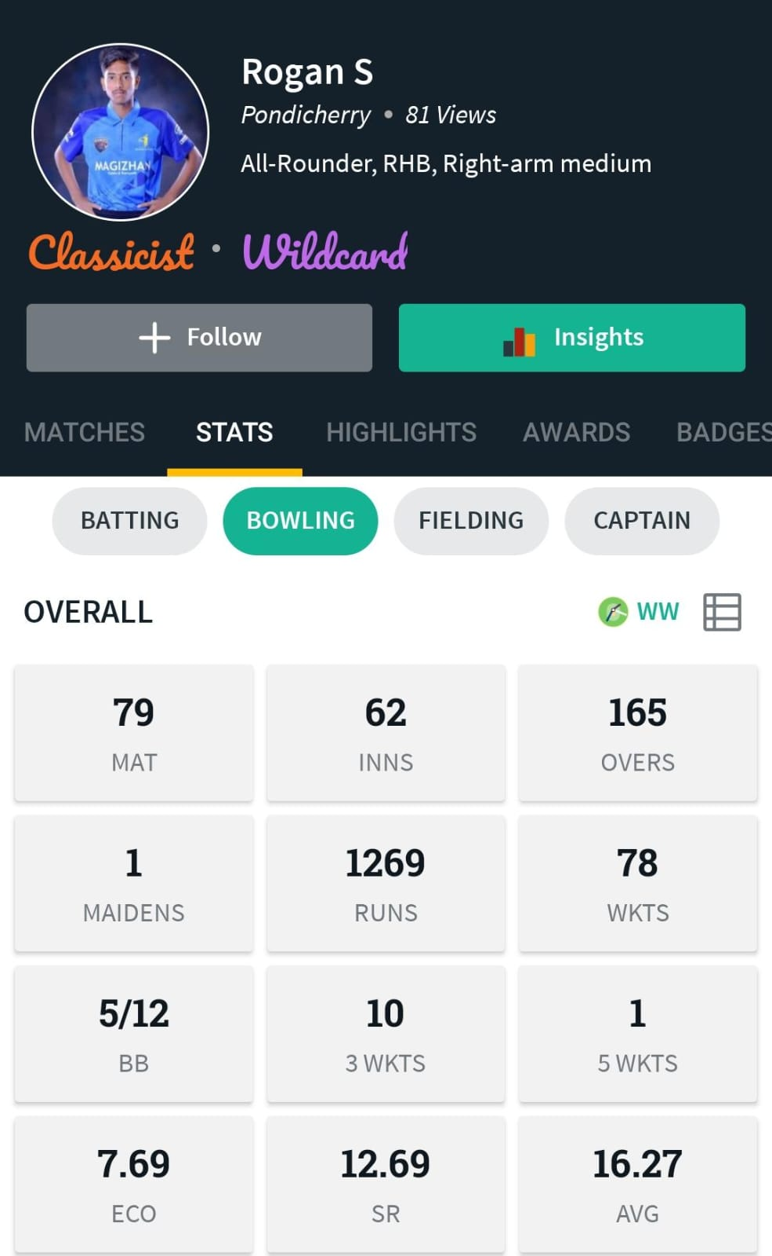
ROGAN bpl020

Slide 21
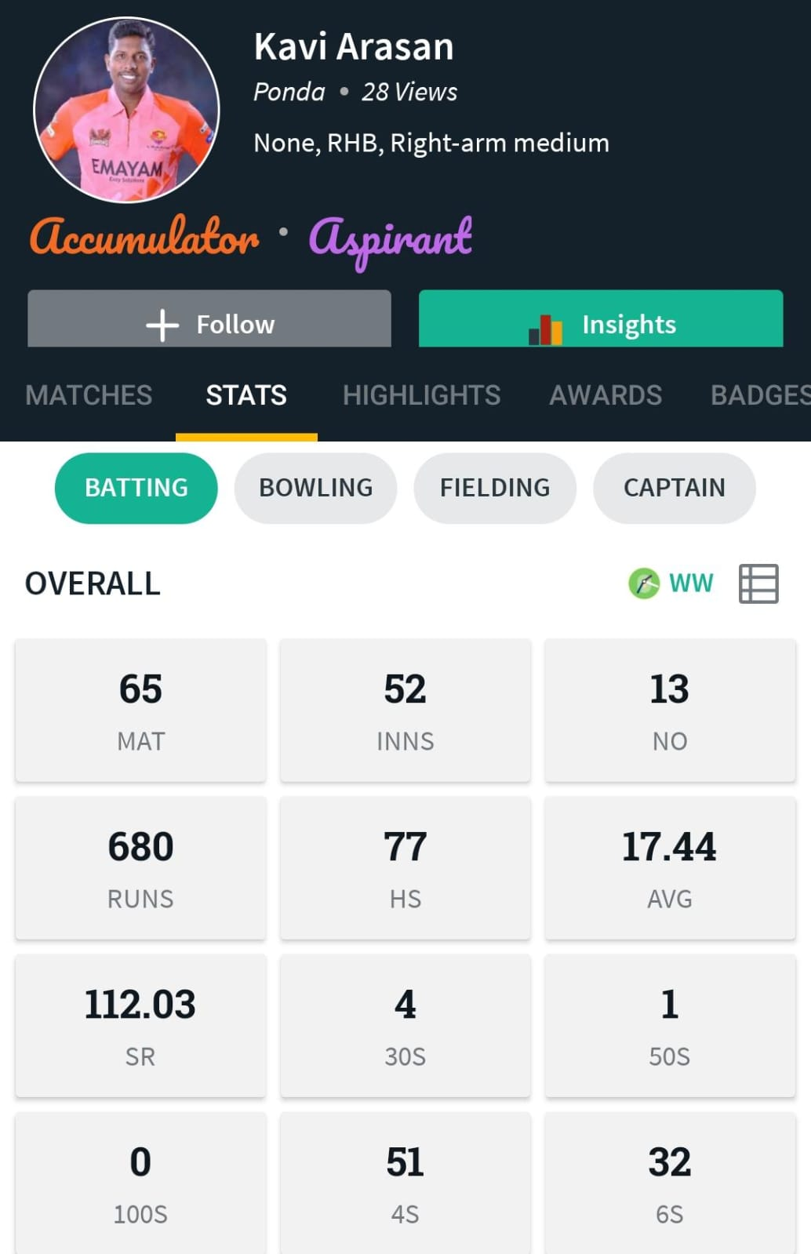
KAVIYARASAN bpl021

Slide 22
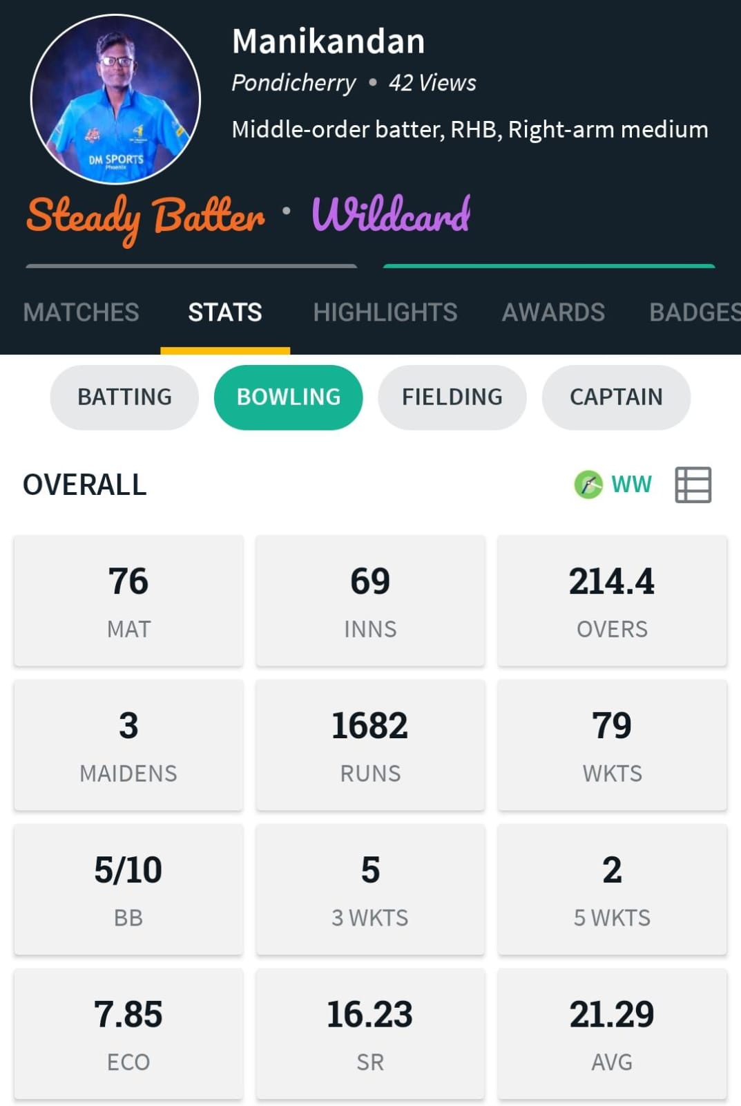
MANIKANDAN bpl022

Slide 23
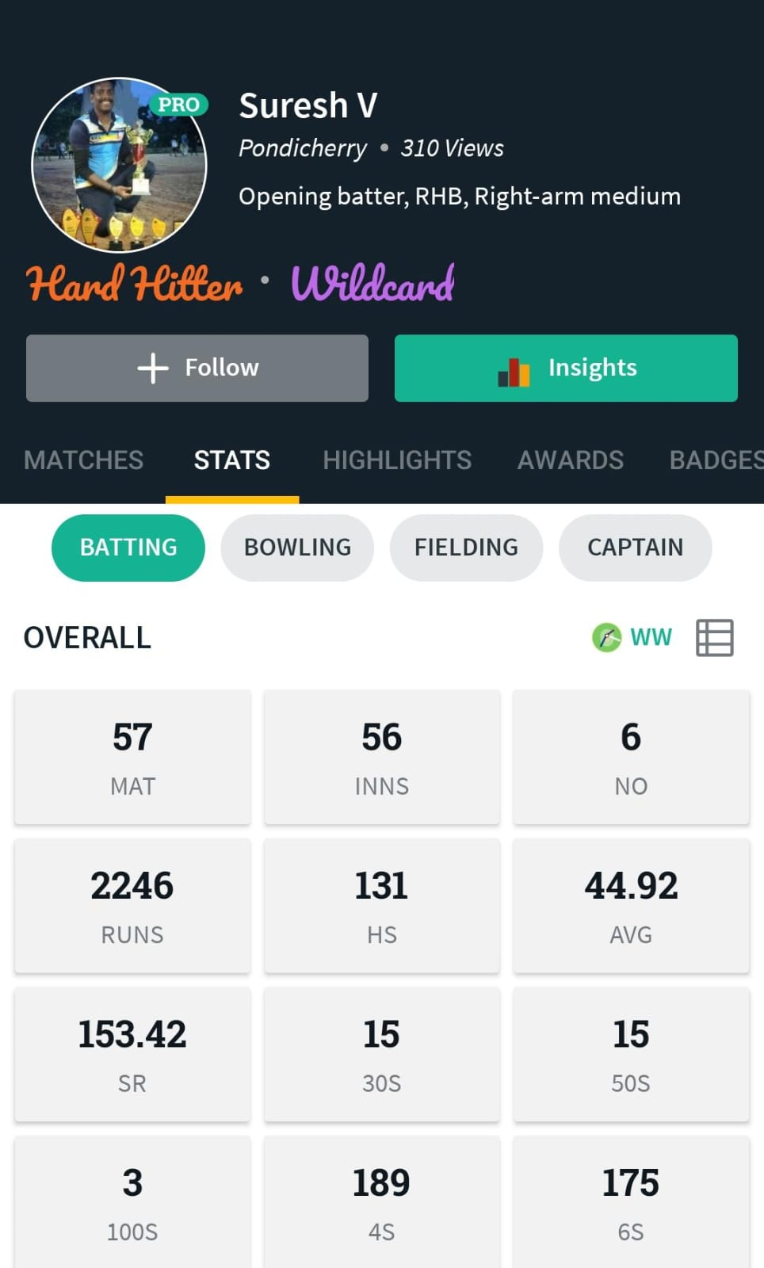
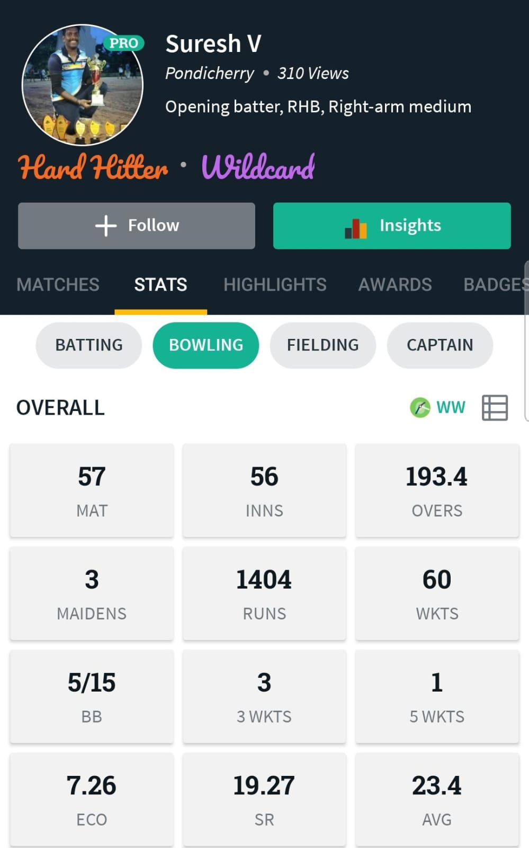
SURESH V bpl023

Slide 24
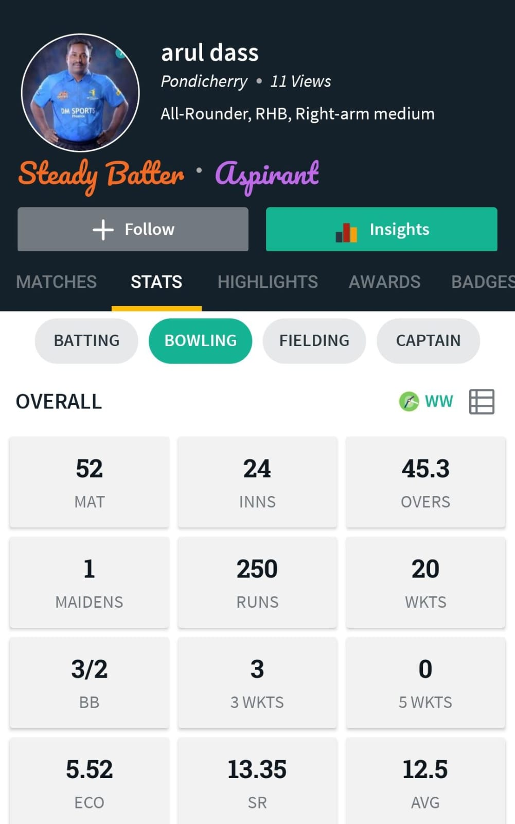
ARULDASS D bpl024

Slide 25
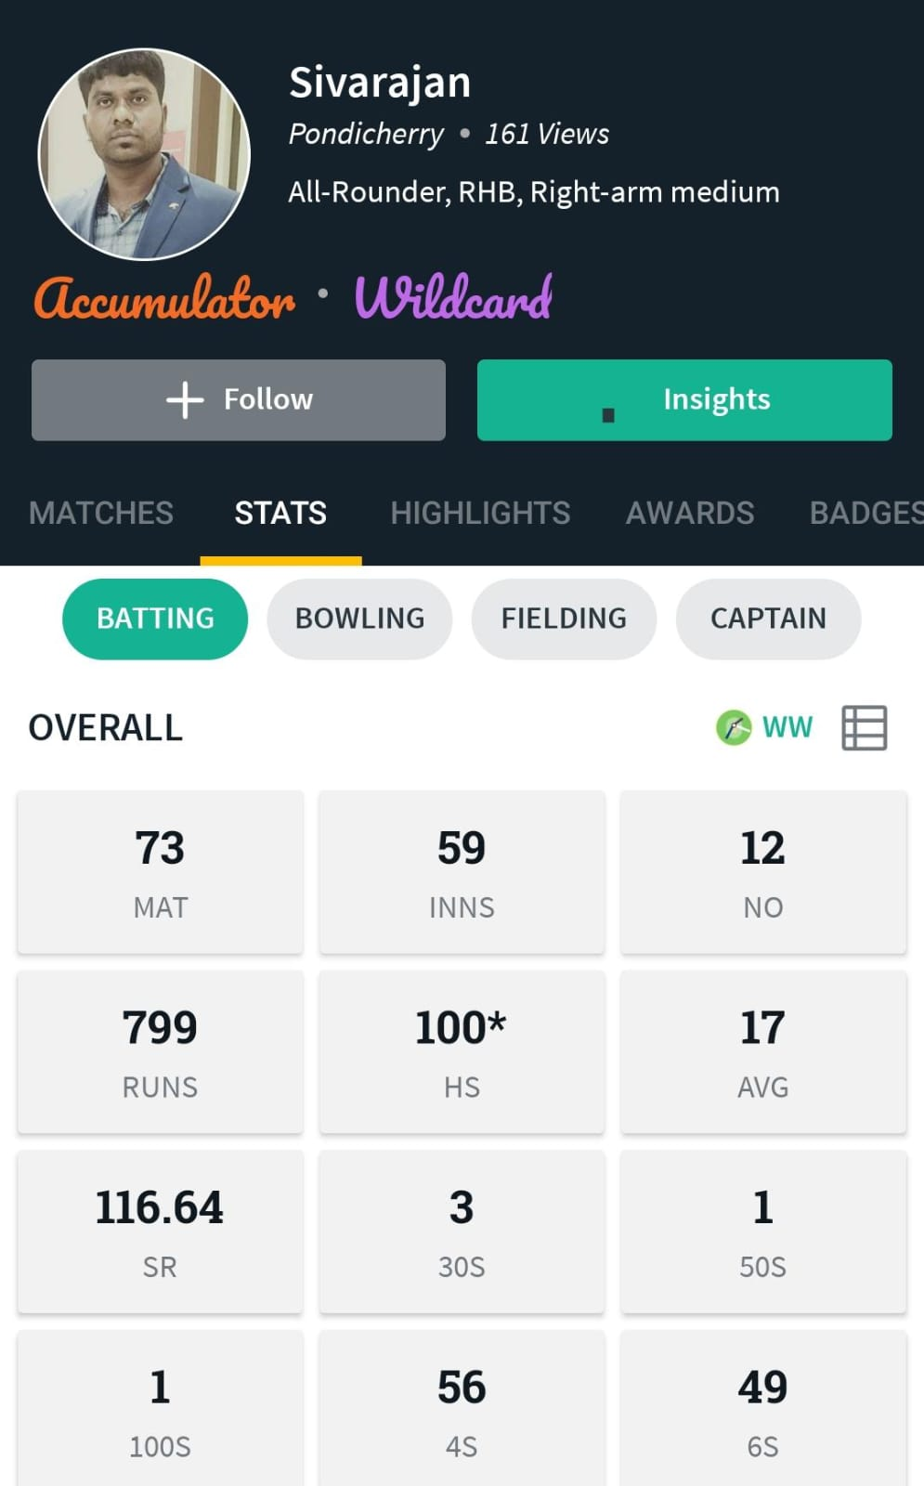
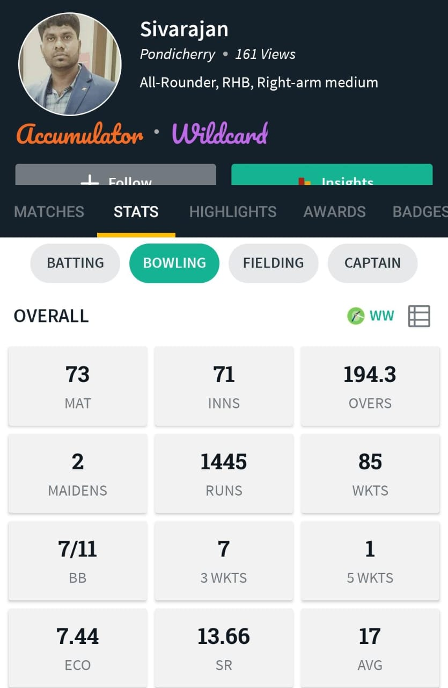
SIVARAJAN A bpl025

Slide 26
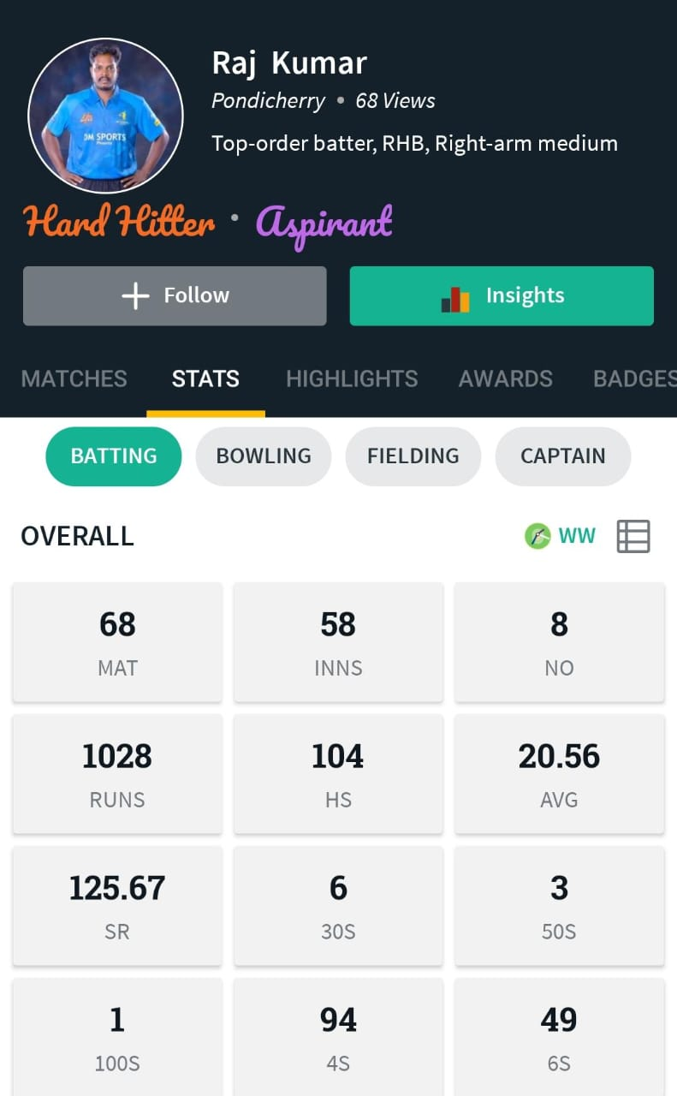
RAJKUMAR R bpl026

Slide 27
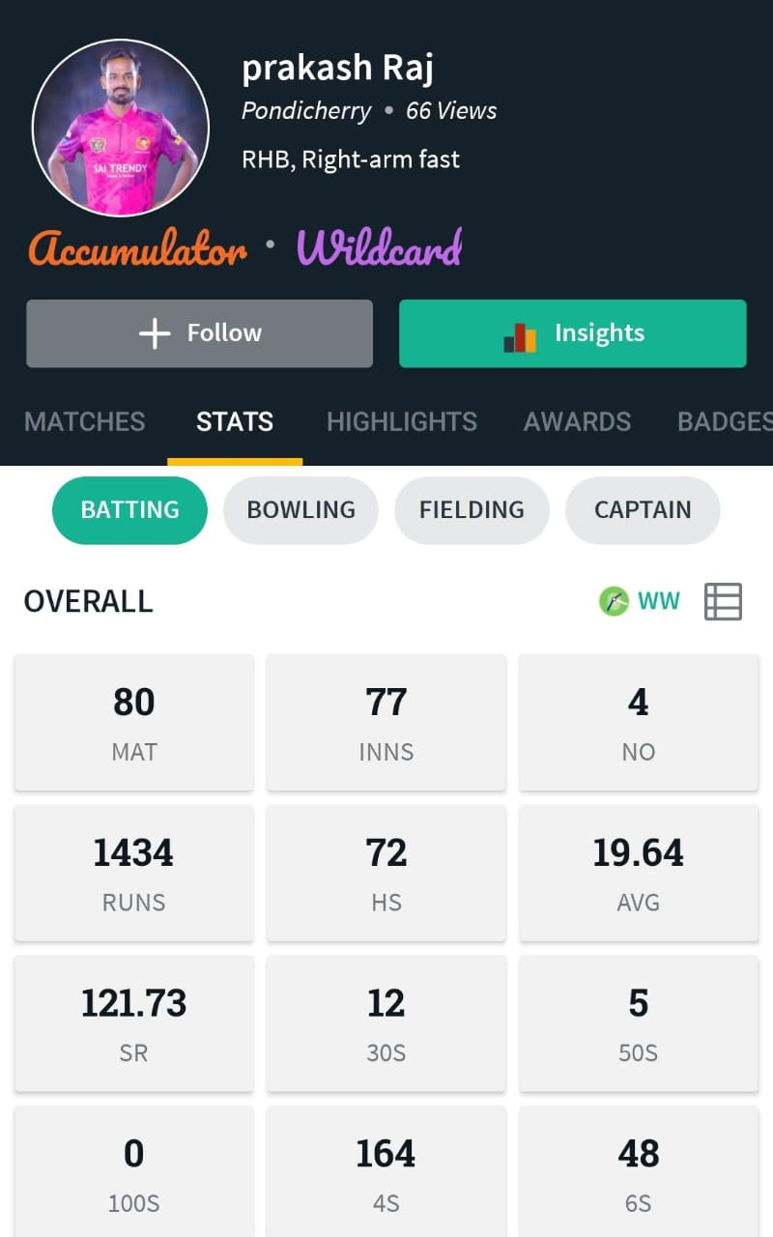
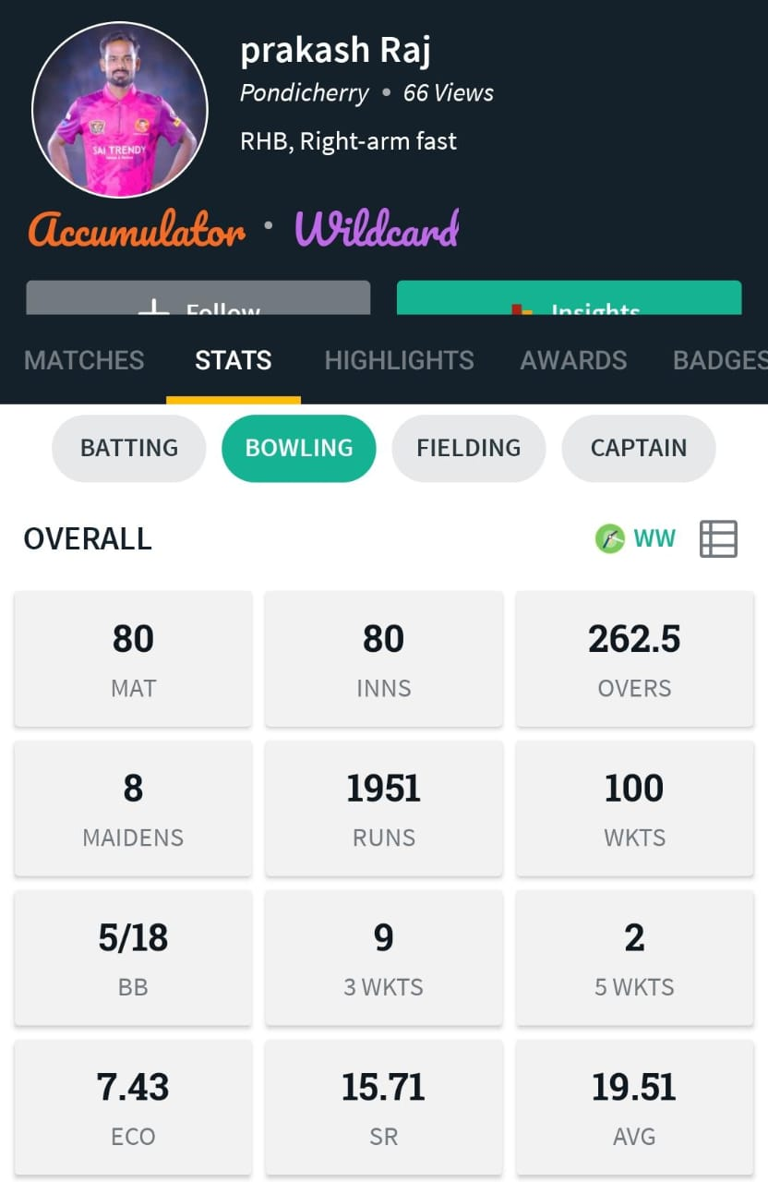
PRAKASH bpl027

Slide 28
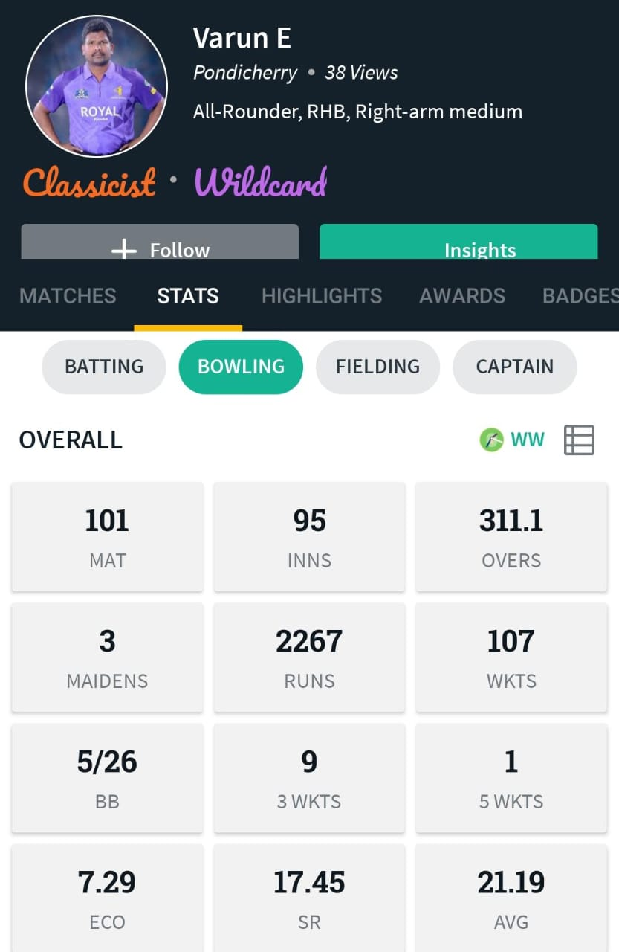
VARUN E bpl028

Slide 29
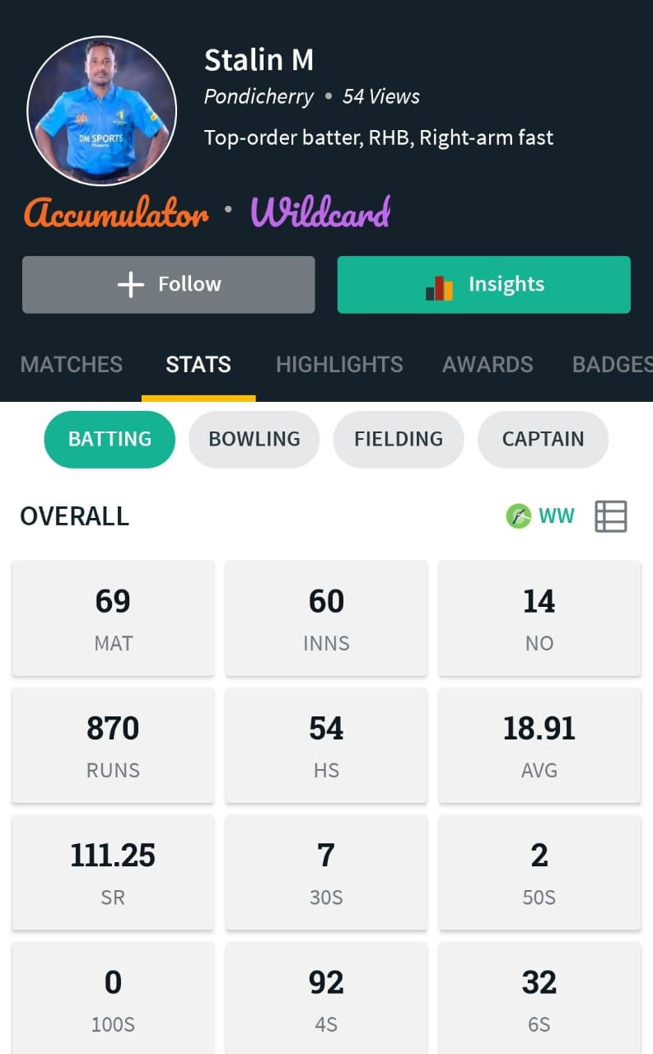
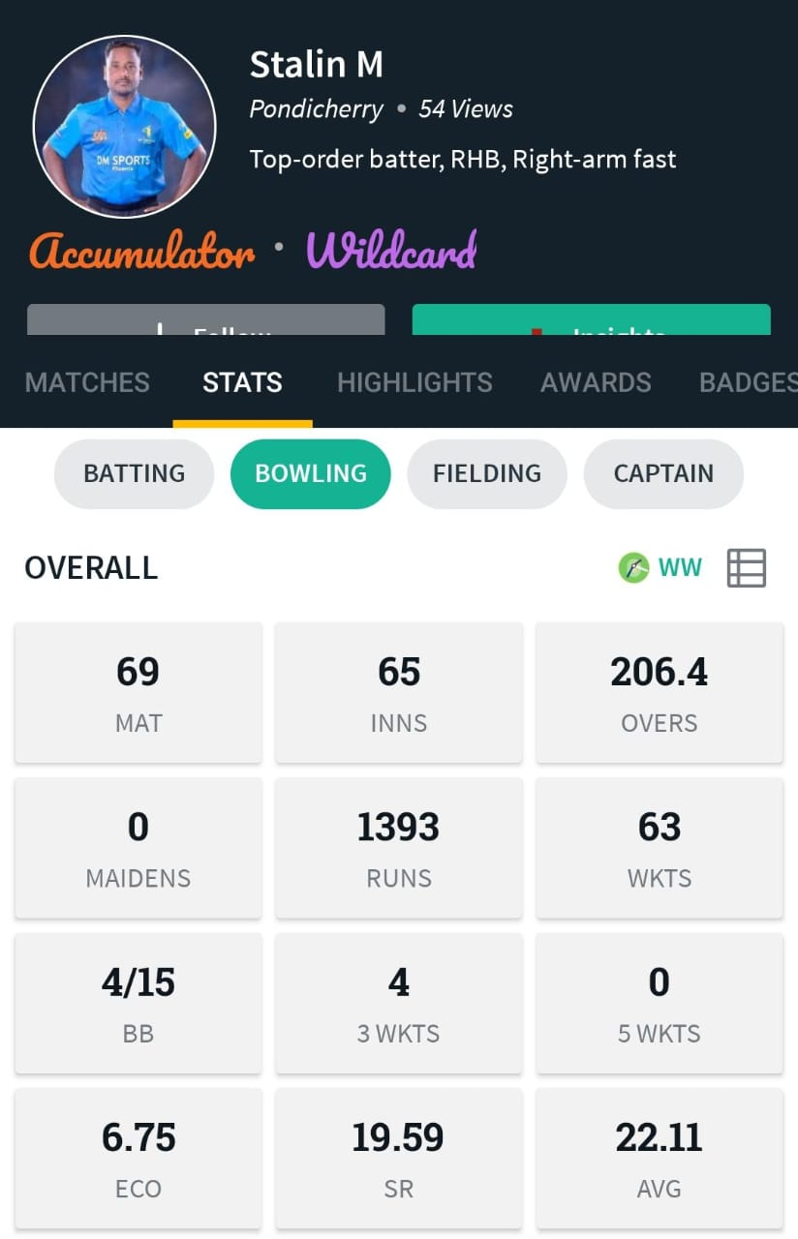
STALIN M bpl029

Slide 30
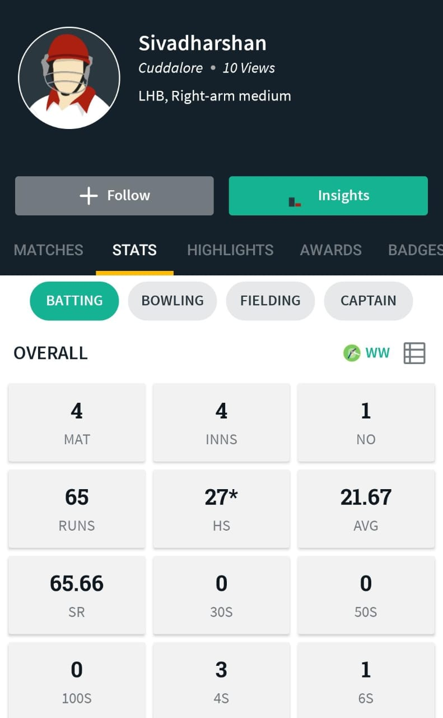
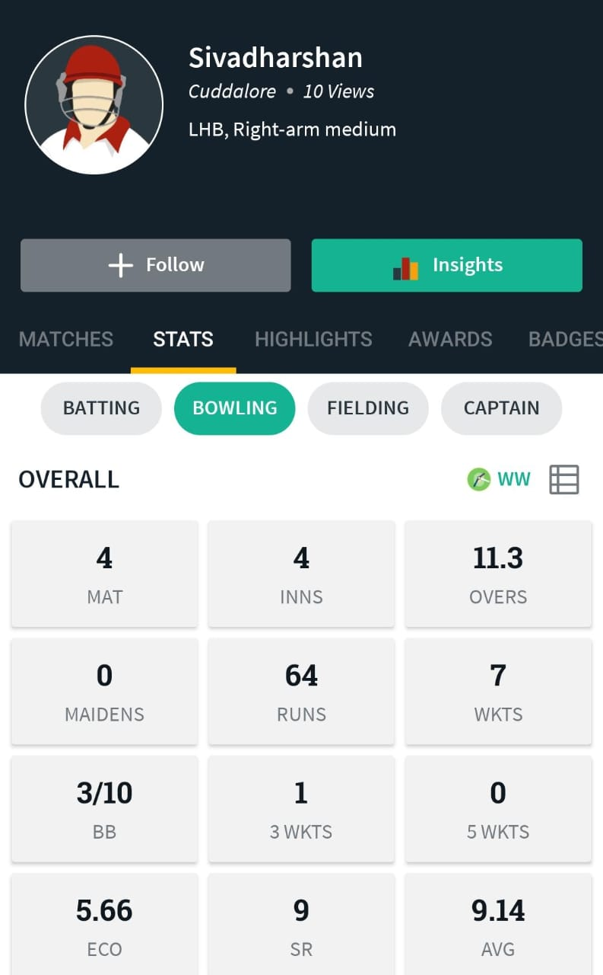
SIVA DHARSHAN A bpl030

Slide 31
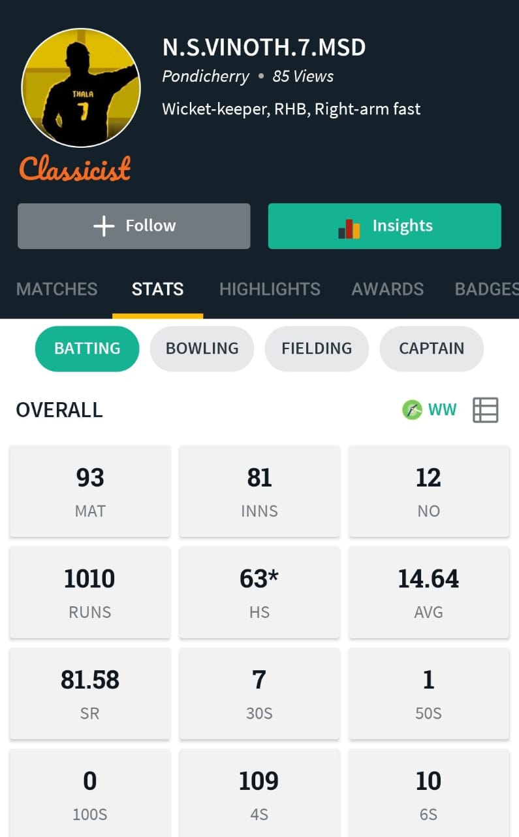
VINOTH KUMAR (WK) bpl031

Slide 32
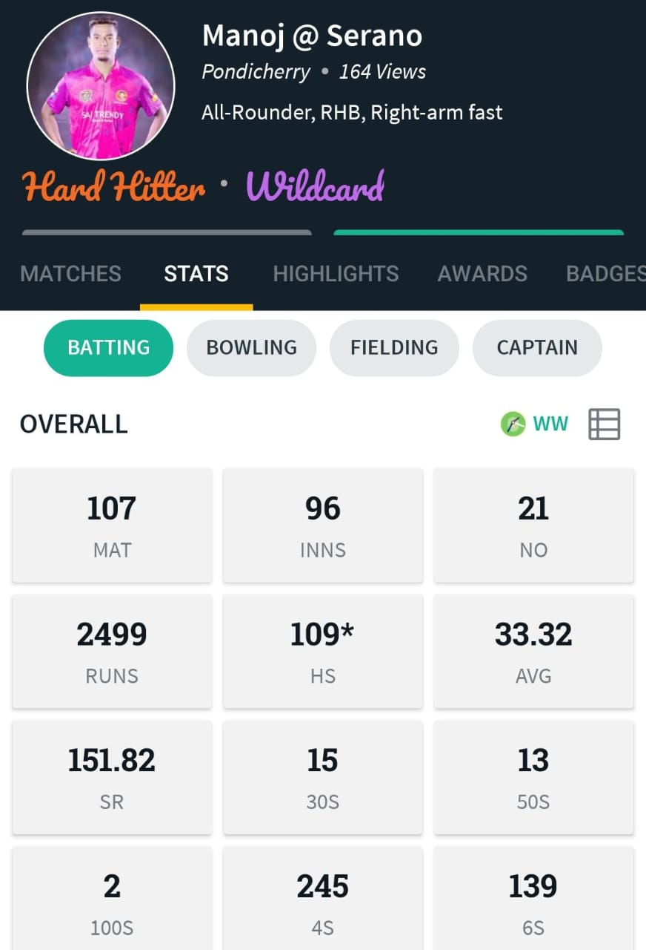
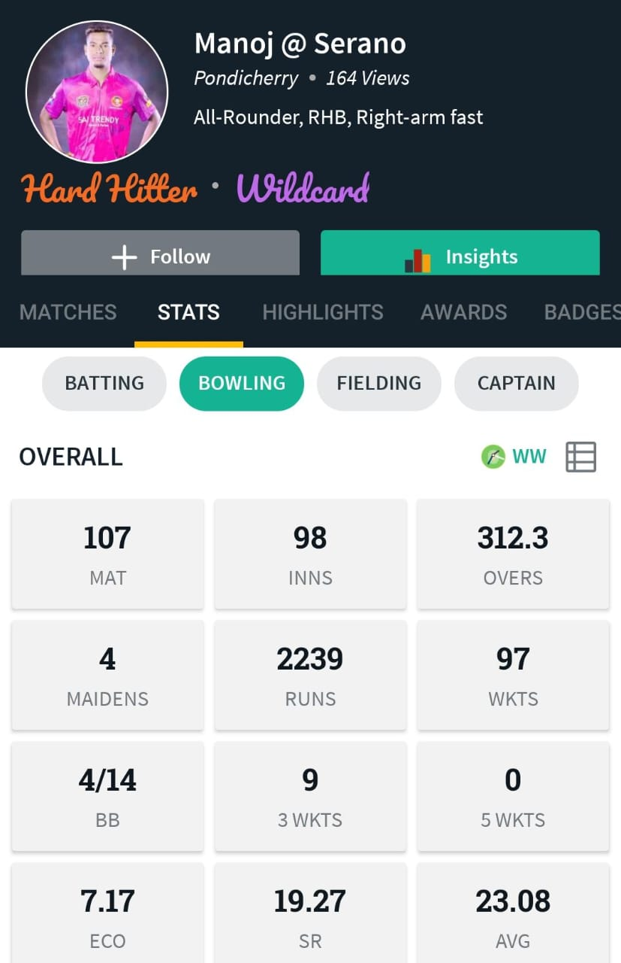
MANOJ R bpl032

Slide 33
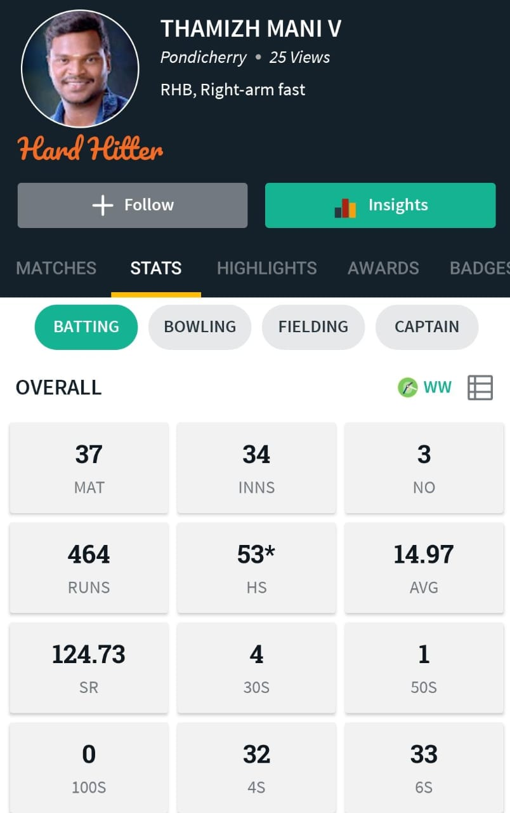
TAMIZHMANI V bpl033

Slide 34
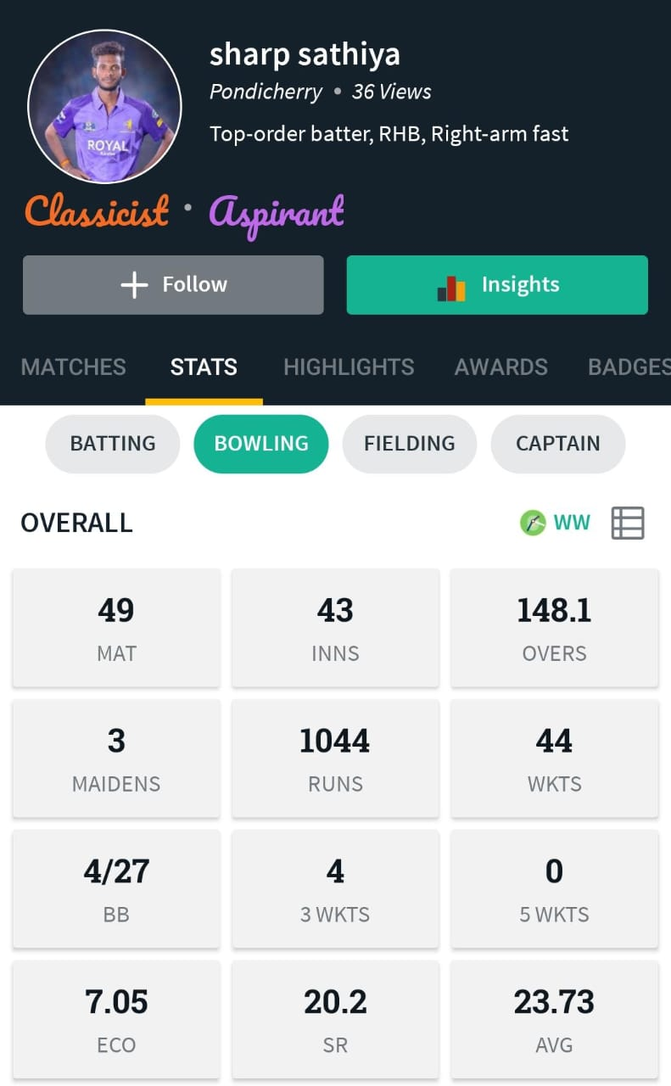
SATHIYA A bpl034

Slide 35
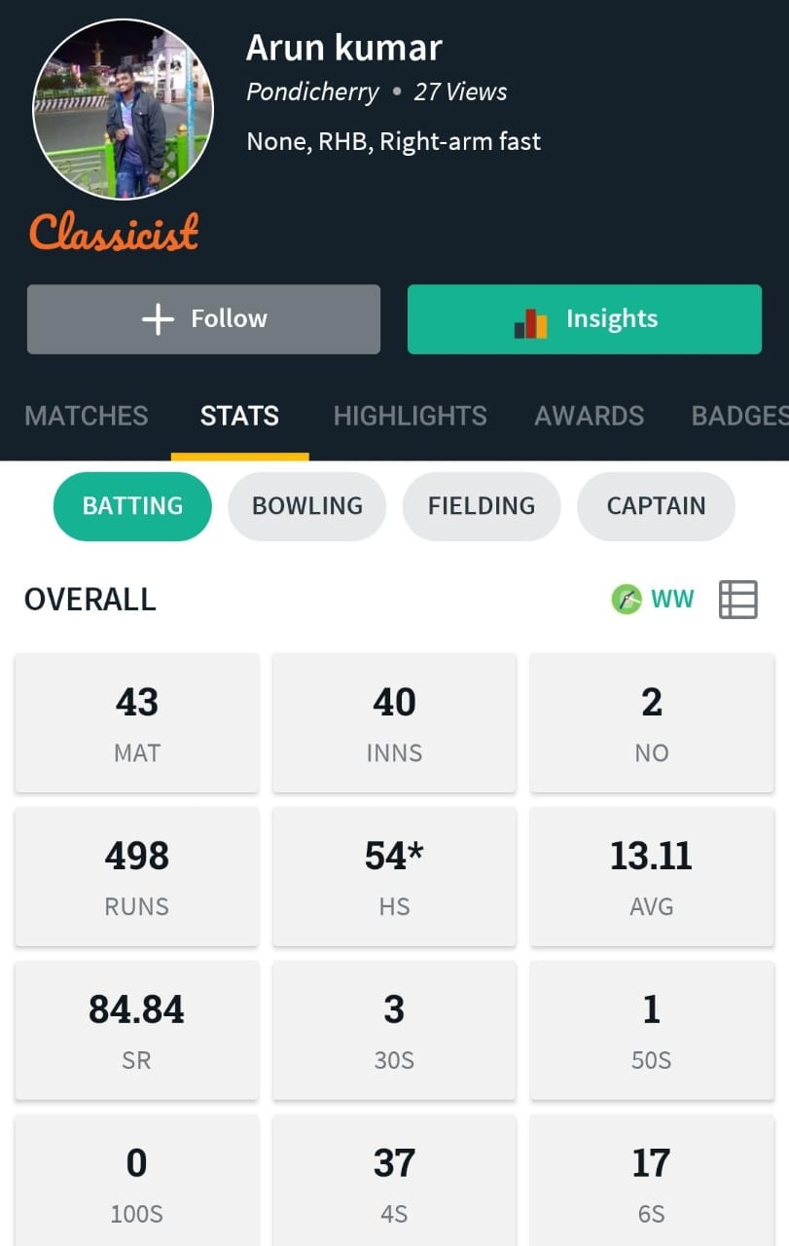
ARUN KUMAR S (WK) bpl035

Slide 36
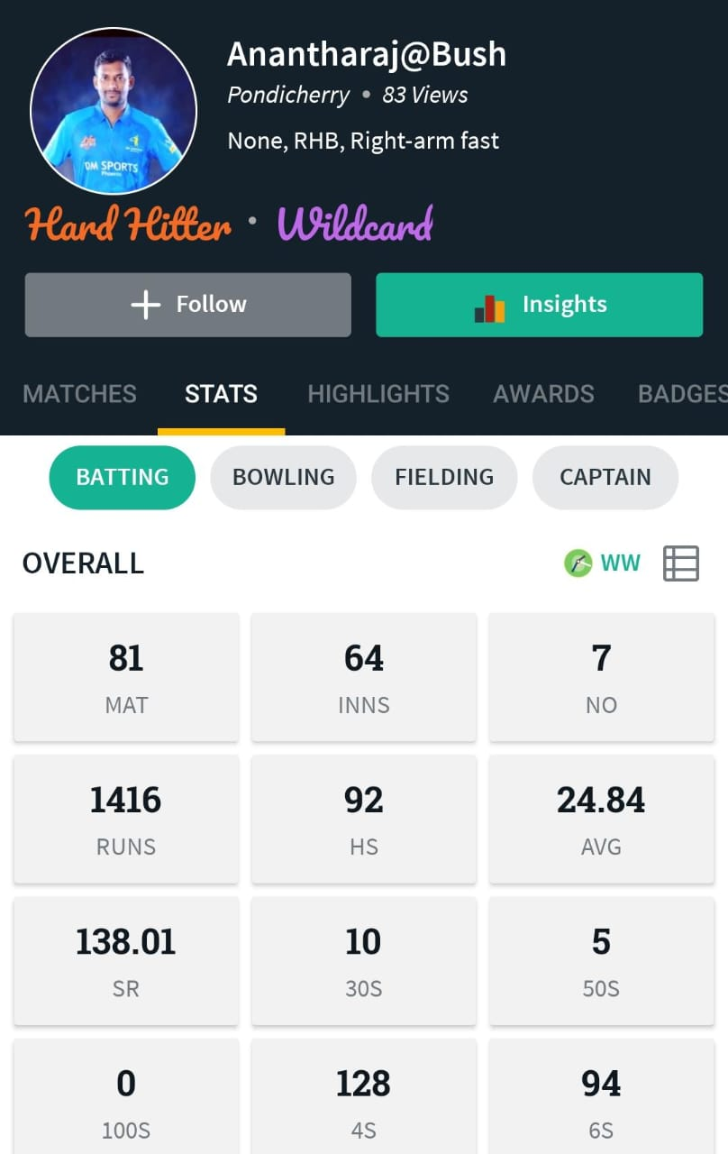
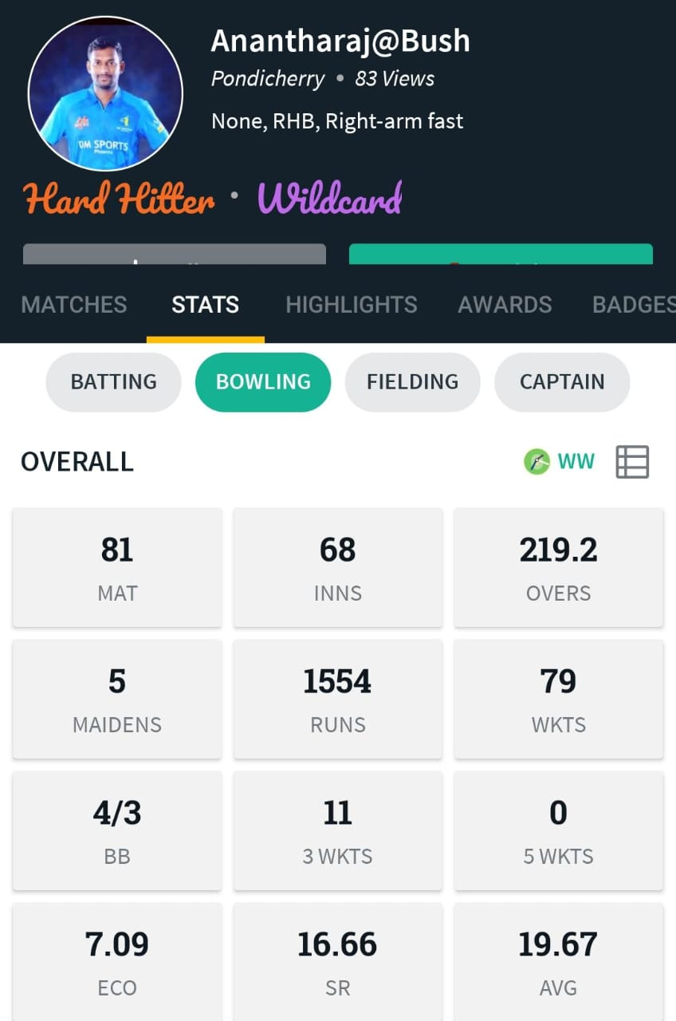
ANANTHRAJ bpl036

Slide 37


MANIVANAN @PRAKASH bpl037

Slide 38

KANNAN bpl038

Slide 39


THANIGAVEL C bpl039

Slide 40


MURALIDARAN P bpl040

Slide 41

YOGESHVARAN S bpl041

Slide 42

RANGANADHAN bpl042

Slide 43

POOMINATHAN R bpl043

Slide 44

KALAISELVAN R bpl044

Slide 45

RAVIKUMAR M bpl045

Slide 46


BASKARAN M bpl046

Slide 47

SATHESH K bpl047

Slide 48

SIVARAMAN (WK) bpl048

Slide 49

SIVAGURU bpl049

Slide 50


MOHANACHANDER bpl050

Slide 51

BALAMURALY T bpl051

Slide 52

AKASH R bpl052

Slide 53


DHANRAJ P bpl053

Slide 54

KARUNAKARAN R bpl054

Slide 55


BARATHVAJ K bpl055

Slide 56

RAJASEKAR (WK) bpl056

Slide 57

PRAKASH RAJ P bpl057

Slide 58

PRASATH V bpl058

Slide 59


EZHILVELAN bpl059

Slide 60


VISHNU PRASANDH bpl060

Slide 61

RAJA PRADEEP R bpl061

Slide 62


KAMALANATHAN R bpl062

Slide 63

VIJAYAN A bpl063

Slide 64


DHANAGODY bpl064

Slide 65

BALAMURUGAN B bpl065

Slide 66


VENGATESHWARAN bpl066

Slide 67

PRATHAB (WK) bpl067

Slide 68


PRAKASH V bpl068

Slide 69


UDHAYASANKAR S bpl069

Slide 70

SAI MANOHAR bpl070

Slide 71

PERUMAL P bpl071

Slide 72

KARAL MARKS bpl072

Slide 73

DHEENADAYALAN bpl073

Slide 74

STALIN L bpl074

Slide 75

JAYAGOPAL K bpl075

Slide 76

NALACHAKARAVATHY bpl076

Slide 77

SARANRAJ P (WK) bpl077

Slide 78


RAJI A bpl078

Slide 79

JEEVANANTHAN bpl079

Slide 80


MUTHU KUMARAN P bpl080

Slide 81

KARTHICKEYAN M bpl081

Slide 82

UMANATH D bpl082

Slide 83

ASHVAKOSH D bpl083

Slide 84


TENNIS PRABU K bpl084

Slide 85

IRAIANBU J bpl085

